Slide 1
WORLD OF DRONE
Drone Application: Scientific Research

Slide 2
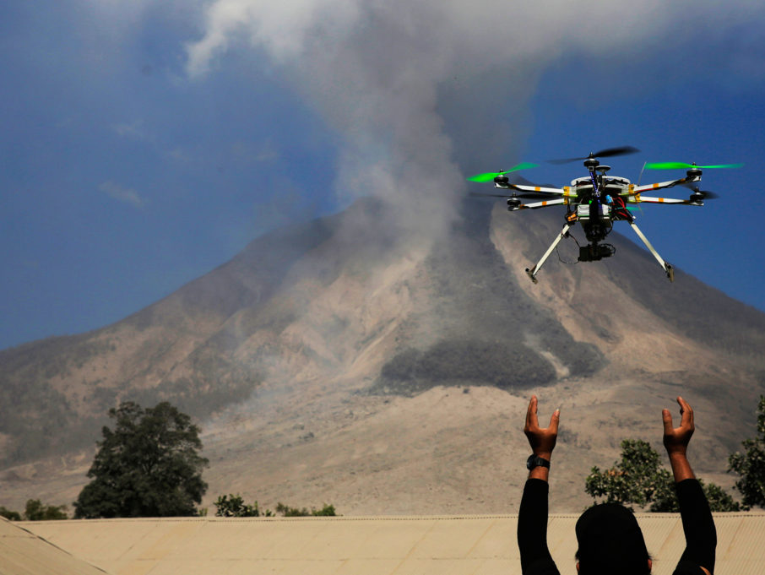
Drone Application: Scientific Research
UAVs are especially useful in accessing areas that are too dangerous for manned aircraft.

Slide 3
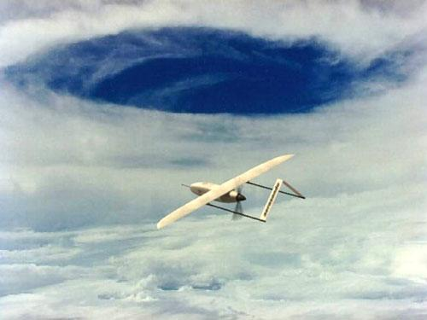
Drone Application: Scientific Research
The U.S. National Oceanic and Atmospheric Administration began using the Aerosonde unmanned aircraft system in 2006 as a hurricane hunter.

Slide 4
Drone Application: Scientific Research
The 35-pound system can fly into a hurricane and communicate near-real-time data directly to the National Hurricane Center.

Slide 5
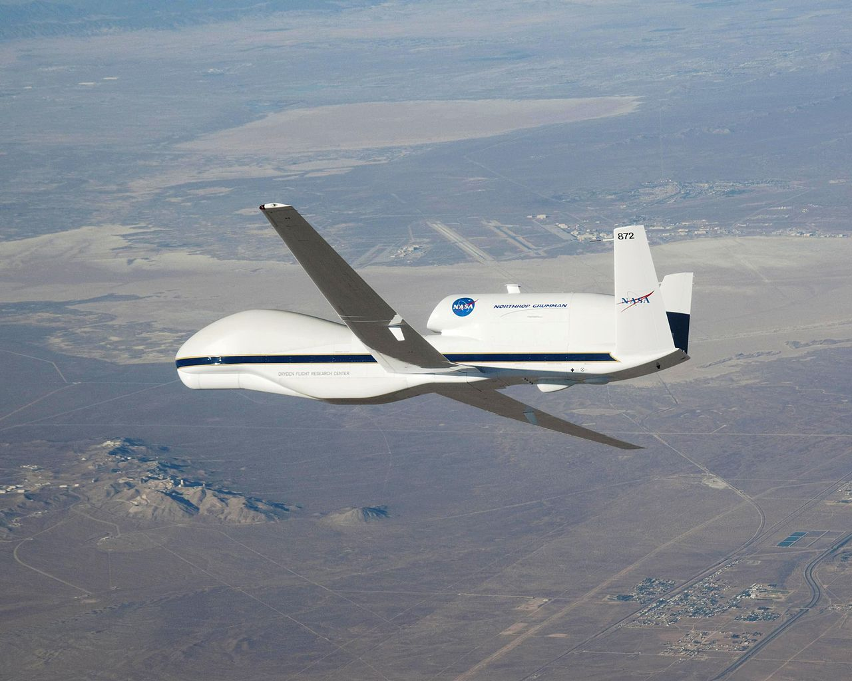
Drone Application: Scientific Research
NASA later began using the Northrop Grumman RQ-4 Global Hawk for hurricane measurements.

